Slide 1
Student-Oriented GUI for Causal Discovery
Jonah King
MSc Computer Science
Project Demonstration

Slide 2
Motivation
Problem: Causal discovery tools provide little help for beginners
Target users: Students and Novice researchers analysing their datasets
Project goals: tutorial-guided, user-friendly GUI for causal discovery
  Tutorials for each step/algorithm
  Parameter selection guided with tooltips
  Explainability: causal relationships, algorithm differences, separating sets

Slide 3
Why a Student-Friendly GUI?
Causality over correlation
  Need causes to reason about mechanisms
  Causal answers are necessary
Algorithm choice overload
  Each with different assumptions (Markov, faithfulness, sufficiency, score)
  Picking the right algorithm and comparing outputs is not beginner friendly
GUI for existing algorithms
  Packages exist with good documentation, but many users aren’t programmers
  GUI lowers the skill barrier for users with less technical backgrounds

Slide 4
Design Principles
Prioritise usability: clean layout to guide the user in the right direction
Learn by doing: algorithm tutorials, parameter tooltips
Explain results: right hand panels explain edges and lack of relationships
Appliable: export graphs/edges/comparisons

Slide 5
Architecture
Frontend: PyQt5 (Qt Designer), Matplotlib canvas, NetworkX, Graphviz for layout
Backend: py-tetrad and JPype for TETRAD’s Java algorithms
Structure:
  App.py: window, docks, tabs, toolbar wiring
  Controllers.py: actions, drawing, exports, comparisons
  Tetrad_iface.py: JVM bootstrap, PC/GFCI/FGES runs, CI helps
  Dialogs.py: wizards (Import, PC, GFCI, FGES), parameter dialogs

Slide 6
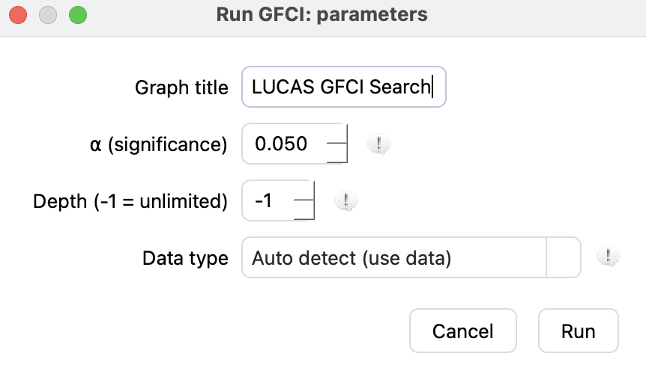
Implemented Search Algorithms
Constraint based: PC – uses skeleton pruning via CI tests and Meek orientation to produce a CPDAG
Hybrid: GFCI – uses score and CI tests to output a PAG supporting latent confounders
Score based: FGES – a greedy equivalence search with BIC penalty discount
Shared parameter dialogs – alpha, depth, data type / penalty, consistent outputs

Slide 7
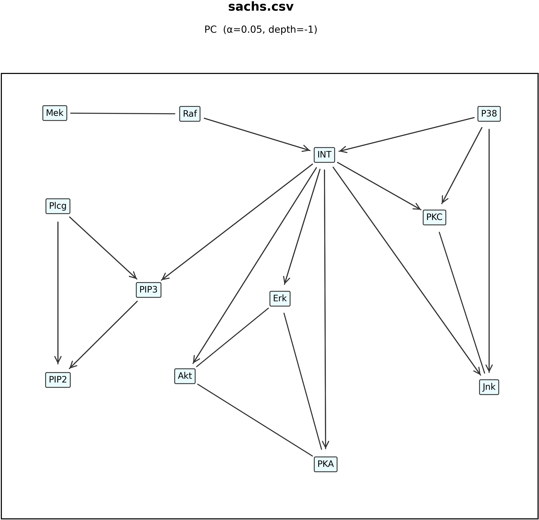
Visualisation & Explainability
DAG canvas: drag node positions, exports to PNG, stable layouts
Edges: directed (A --> B), undirected (A --- B), partially oriented (A o-> B), bidirectional (<->)
Why not connected?: finds separating sets explaining removed edges
  Continuous: Fisher-Z using partial correlations
  Discrete: conditional χ²

Slide 8
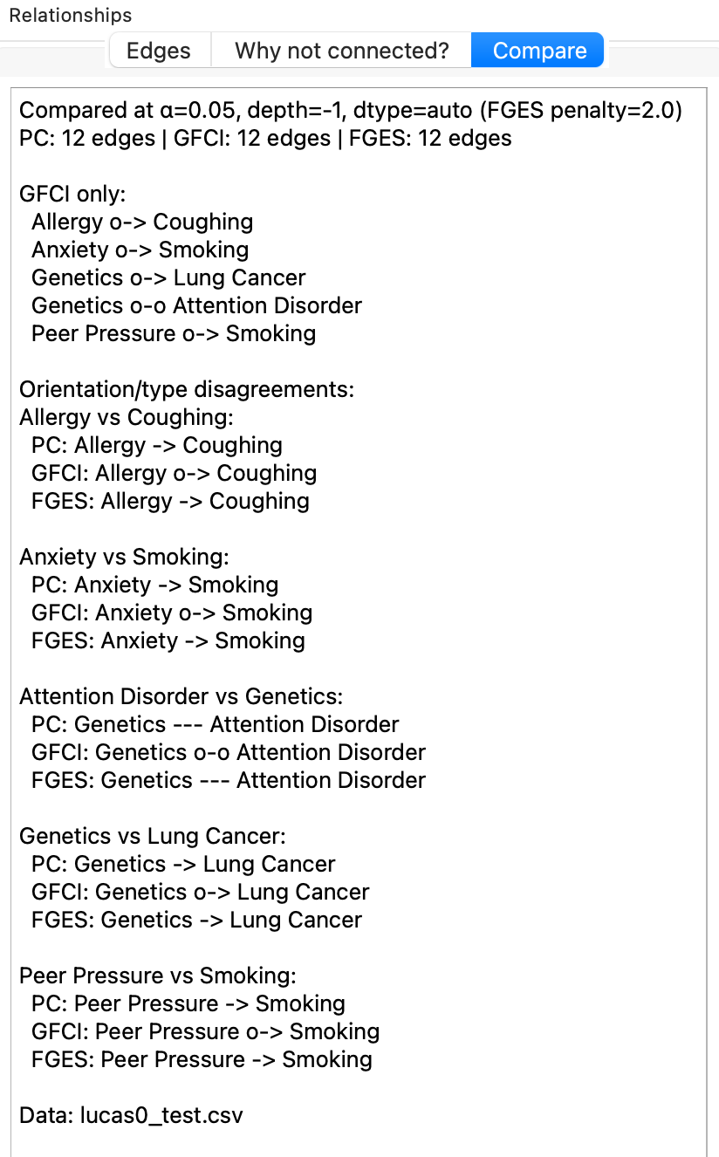
Algorithm Comparisons
Compare tab: runs the three algorithms with the same data and parameters
Reports unique edges per algorithm and orientation disagreements for each variable pair
Exports text report (header, counts, unique edges, disagreements)
Value: shows how algorithms, alpha, depth, and score penalties affect structure

Slide 9
Demo & Example Datasets
Demo flow:
  Import CSV -> choose PC/GFCI/FGES -> inspect DAG edges -> why not connected? -> compare -> export
Dataset used for testing:
  LUCAS (lung cancer synthetic dataset) containing 12 variables commonly associated with lung cancer and smoking
Search for: stability of core edges and algorithm differences flagged

Slide 10
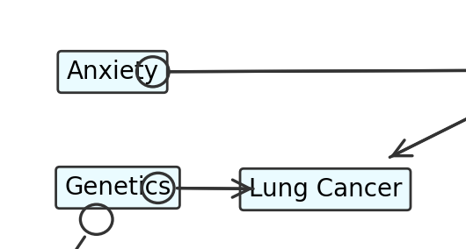
Limitations and Risks
UI blocking on large runs (synchronous)
Rendering edges can overlap at certain angles (visual polish needed)
Dependency on py-tetrad algorithms

Slide 11
Conclusions and Next Steps
Outcome: beginner friendly causal discovery GUI with tutorials and explanations to guide the user
Key contributions:
  PyQt GUI, tutorial wizards, comparisons tab, endpoint rendering, exports
  Py-tetrad integration, parameter customization, explanations tab
Next steps
  Threaded runs and cancel/progress bar, SVG exports, figure legend, unit tests
  Usability study with students: time tasks, understanding, user confidence
  Teaching implications for MSc modules
  LLM powered Q&A in “Why not connected?” to answer questions about the DAG

